Slide 1


KATTHE SOFTWARES AND SOLUTIONS
Who We Are?
“KATTHE”: Derived from Kannada word(ಕತ್ತೆ) for “Donkey” Symbolizing loyalty and hard work.
Project1: SmartTown.in Centralized –Specific-Town Based –Easy-Self Controllable System & replicable

Slide 2


FOCUS
What are our Focus?
Transparent & Corrective Systems Using Technology:
Commercial and non-commercial applications.
Proper Utilization of Existing Resources
Simple & Social Awareness wrt Technology
Educating Through Direct channels, Social media, Schools and colleges.
Direct Contribution to Needy People:
Connecting options for Giver ⬄Needy
Non-Standard Requirements addressing in right effective way
Building Self Growing with Recovery & Replicable Systems
Sandboxed & Cost effective by avoiding Unnecessary inclusions

Slide 3

Our Projects (Few)
What Projects We Are Doing?
SmartTown.in (MVP1 Almost Ready):
Connects every part of a town, including local businesses, shops, feedback, ratings, government news, services, especially Rusting resources highlight
Addresses the limitations of existing platforms for small local businesses.
Hennu.in(Ideation):
Dedicated to girl/women safety & empowerment
UnWell.in (MVP1 ready):
Making health and medicines affordable for everyone (currently non-commercial).
ConnecTogether(Ideation):
Platform which connects all Freelancers & Industries for Non-standard / Customization works on top of existing.
…

Slide 4


Office & Team
Where is Our Office & Team?
Registered office:
Bhadravathi,Karnataka,India
Core Architect:
Madhusudhan V
Worked with Multiple International Key projects
Ex Employee of Wipro,Tcs,Dxc,Adlib,RSI..
Connecting by Many: Global contributors & Freelancers
Non-Technical Contributions:
Housewives, Handicaps, Retired Experts & Individuals, Students, Teachers, Press-Reporters, Freelancers, Government Employees

Slide 5


Core Technologies
What are Core Technologies?
Mostly Web technologies for easy connectivity.
Microsoft Technologies, with support from Google & Amazon
Open-source regular research and contribution by which utilizing those to client requirements.
Expansion with Artificial Intelligence

Slide 6


Project1: Town Problems ?
What Project 1 Addressing Problems?
In Most of Towns(+Area),
We don’t have any proper Centralized platform for query like,
Is Any Skin Doctor in town available & what time?
Is Hotel open now & what menu available?
Is Government Hospital Orthopedic Doctor available?
What are locally available ingredients or resources
As a owner, how can I tell users for next 1 week my shop closed before they arrive here.
what is there, what is Not, What is Missing, Important News, Latest Updates, Crisis.
What is required? What is more available? What time its Open/Closed/Available?
Is it live data/menu/Products list?

Slide 7
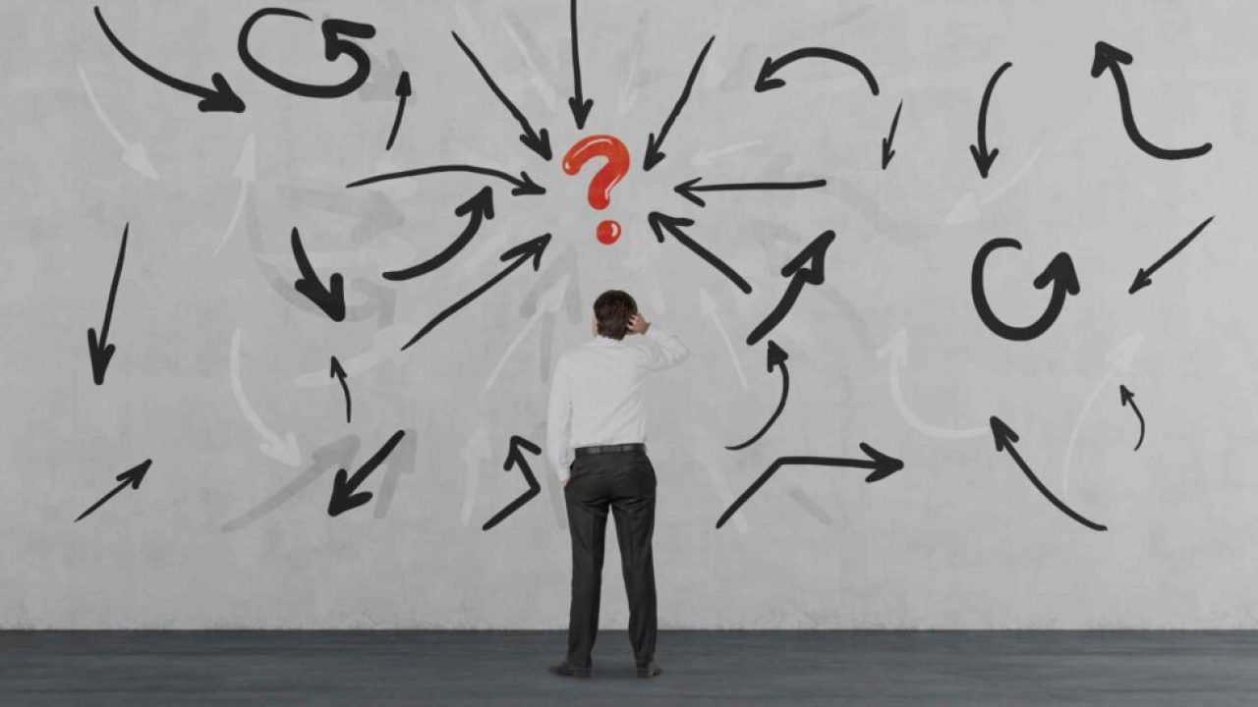

Problems …
Problems identified on Research by Survey ?
Is tomorrow Power Outage?
Anyone started new business/shop/clinic but how to advertise & where? How to share Offers of bike/car/mobile/bank loans?
Local talents how to expose their value
How to advertise only to my specific town & save cost?
Which brands available or where?
What business can we start?
Where to share easily at one place flash important news of town?
How can we connect existing process & improvise easily at one place?
Is Cabs available at particular town as a user?
Being a TempoTraveller Driver/Owner, How to share my details to customers for trips & which days am on/off.
[Without Paying Commission]
Like this we did lot of survey & trying to figure out right possible fix for most of all.

Slide 8
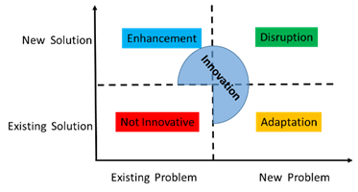
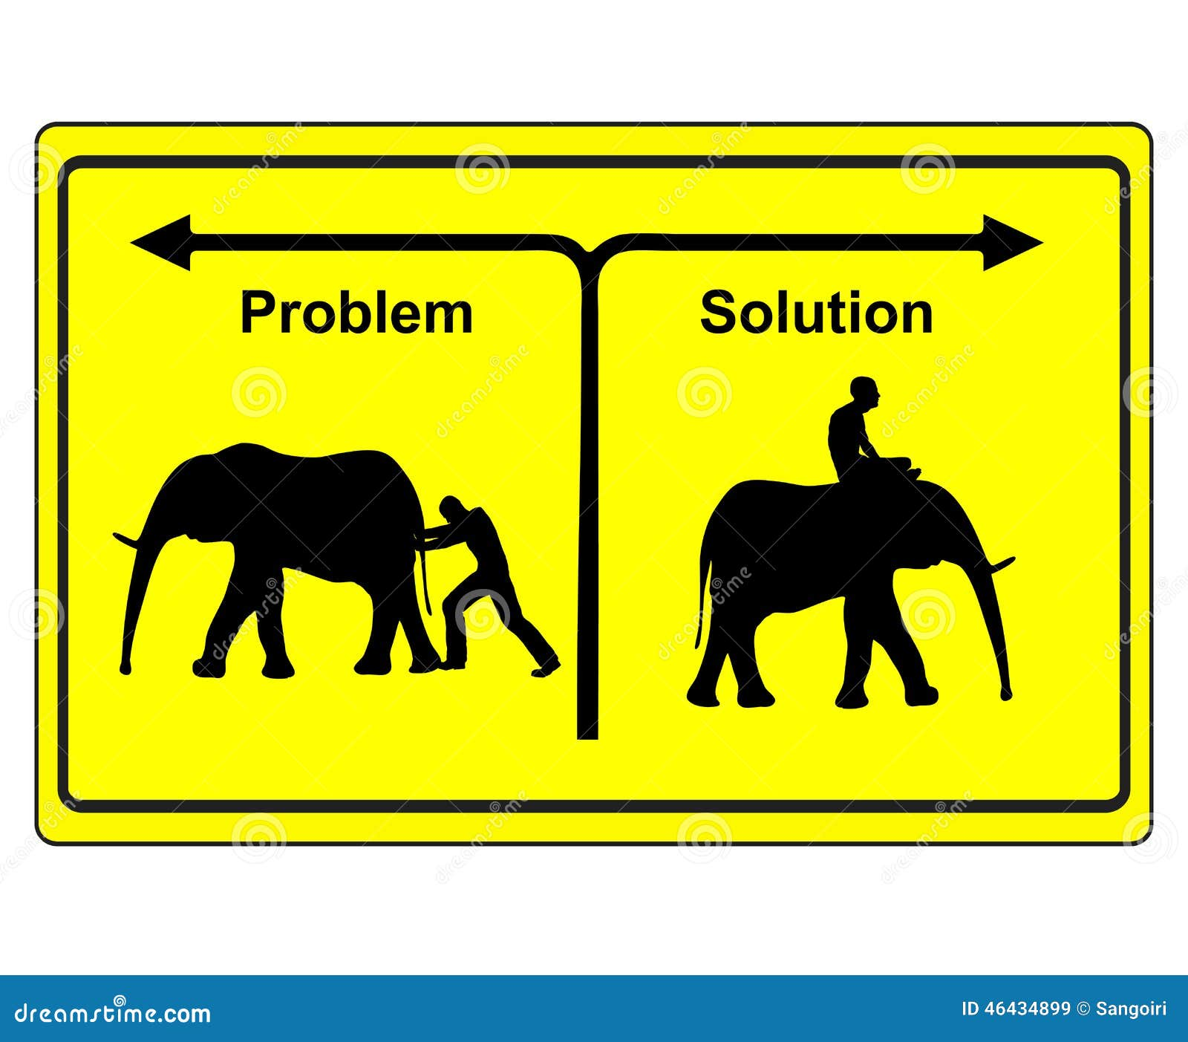
Existing Solutions
What are existing Solutions?
Google Business Maps
Unzo, Ola, Uber
Many Town based Apps
But is they Worth & right solution for All Towns?

Slide 9

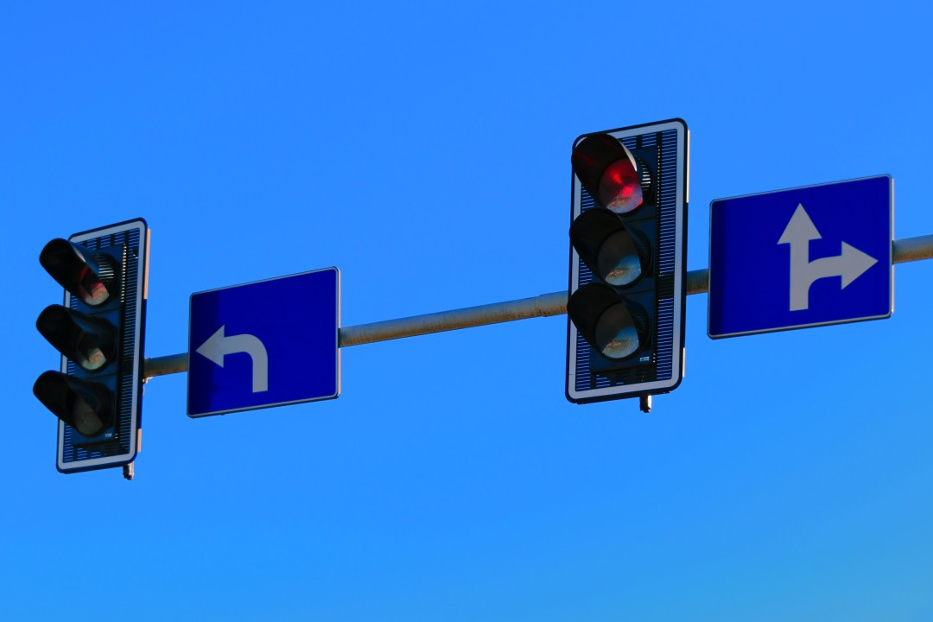
What’s Wrong With Existing?
What is Wrong With existing Solutions?
Not segregated for Specific town , mixed with infinite data
Too Much confusion to choose the right
Advertising cost is Very high
Many Platforms expecting high commissions upto 40%
No Live Data of Menu/Products (Google Business)
Not easy to operate by all & mostly international kind of standard
Validation & Updating of simple data like PhoneNumber/Details is tedious
Not available for Small Towns (Ola,Uber,Unzo)
Fake Data(Facebook Marketplace, Whatsapp business)
Lack of Transparent Reporting & Easy controlling

Slide 10
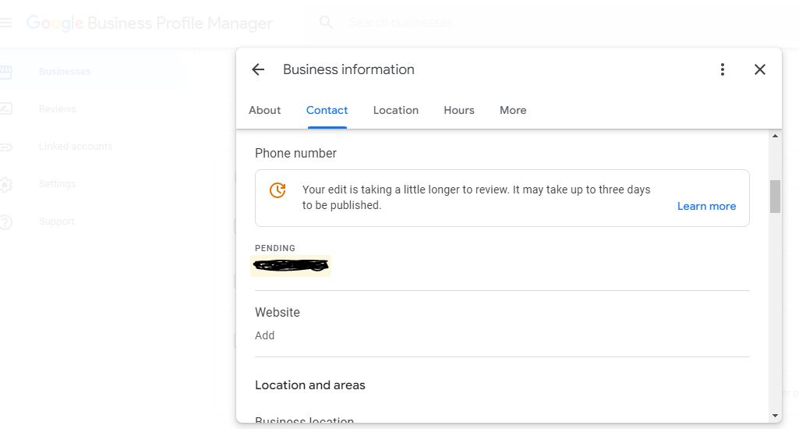

Slide 11



Minimum Cost of Advertising for a Small Garage/Salon Example
Facebook/YouTube/Google: Minimum 1600Rs/for just 1 day
Cost is too high but its GENUINE expenditure for them. Because they show it in global platform to billions of users.
But why do small town business need all those?
Many free options but no proper validation/filtration.
A small Shop 15days advertisement Cost leading to ~30k/month, does he capable? But His total profit itself less than that.

Slide 12
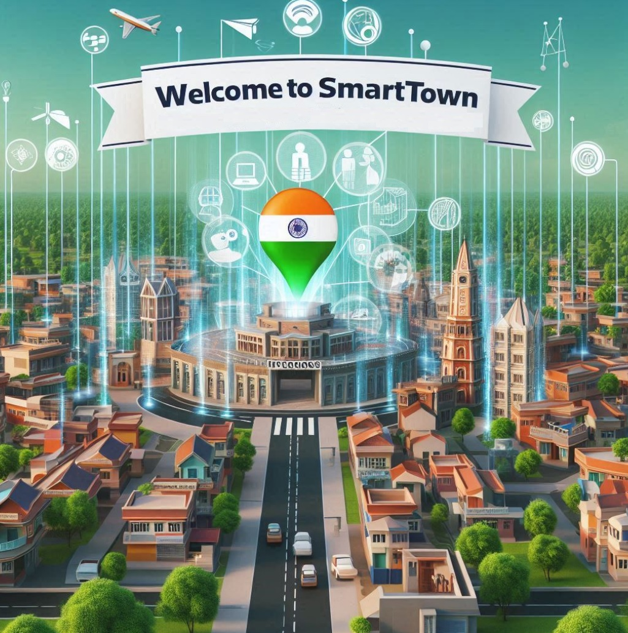

Our Solution: SmartTown.in
Our Solution to Address Problem?
Centralized Segregated Dedicated Town Based system
Each business/Entity will have a Profile=> iCard (Internet Card Holding all at one place just like earlier days Business vCard).
Forever the place is reserved for the user with direct link.
iCard Can be added by Self or Through others (with rewards).
Each Added iCard can be used with any other town with selection & also sharable permanent link SmartTown.in/Bhadravathi/5 , iTown.in/bdvt/YamahaDealer
iCard goes through validation of either Admin/Peers
As A Viewer, Freely always it appears for current town segregated data only, No Mix-Up with other towns data
As a owner always can add/update Menu/Products any time & live/instant with respective paid option.
Flexible & Affordable display cost like 30-50Rs/Day & & no limits of user hits & cost increase like G/F/Y

Slide 13


SmartTown.in
Our Solution to Address Problem…?
Accessible on lower end devices & remote areas Offline Sync
No Separate App is required , so always SECURE
We are not ignoring any existing working solutions instead we will connect them like Channels of YouTube, Facebook, WhatsApp, Instagram, Twitter all in one place
Showing The facts with proper researched data & allowing others to share & discuss in the platform with valid right features.
As like other competitors we don’t be part of any Profit Commission, instead we charge only for what we serve with minimal Completely Transparent Profit.
Adding More & More regional friendly features starts from URLs/link like bdvt.in or Bhadravathi.com or iTwon.in or Nagara.in all serving same

Slide 14
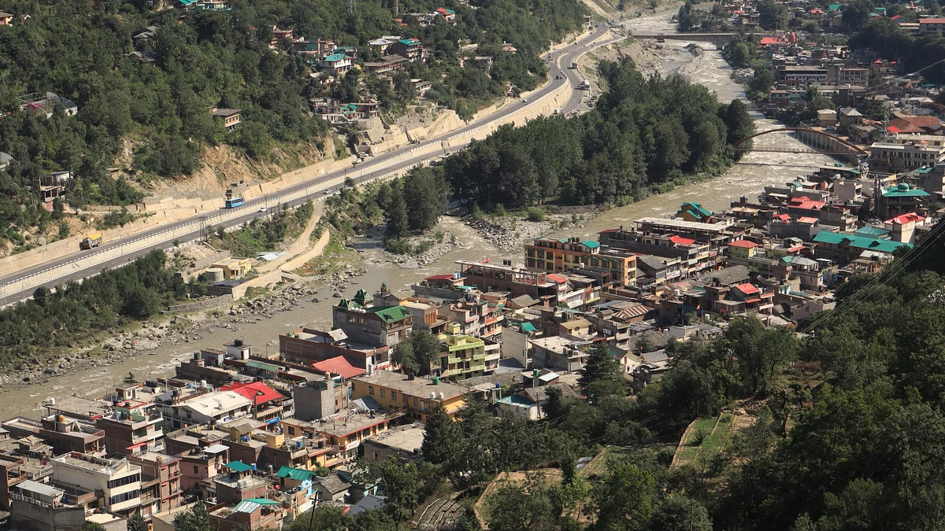

Making Ideal Towns Inclusion Gradually in Order:
What order we are applying the solution?
bhadravathi.com bdvt.in
kadur.in
shmg.in
tarikere.in
birur.in
honnavar.in
nagamangala.in
arsikere.in
hoskote.in
sakrebyle.in
tiptur.in
& more
smarttown.in
itown.in
isitis.in
nagara.in
katte.in
help-me.in
new-india.in
next-action.in
next-choice.in
next-step.in

Slide 15


Uniqueness
What is Special with us?
Simplicity & Segregated Sandbox
Easy & Friendliness
Self-sustainable
Affordable
Completely Segregated data of Particular Town & section
Validation of each iCard/Profiles
Live data always
Offline & remote Serving with Sync
Self replicable & Serviceable to any number of towns
Admin-Independent System & peer validation
Always ready for expansion & Customization

Slide 16

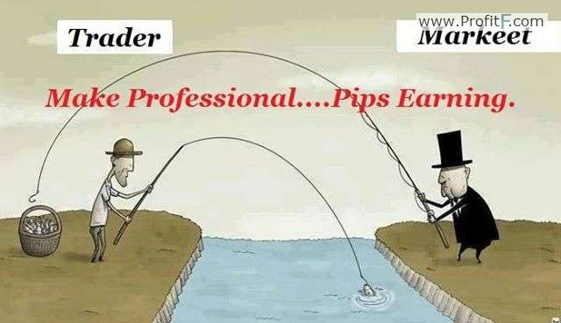
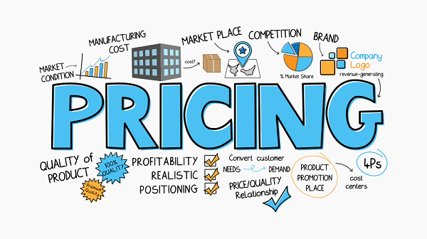
Market Revenue
How we earn in market & Pricing?
Targets small and medium-sized towns and cities with limited access to user-friendly local information platforms.
Revenue streams:
Business Registrations
Advertisement fees (flexible pricing for local businesses)
Data Verification Fees
Revenue Sharing with partners
Sustainable Model: Scalable platform with minimal operational costs.
On Every interaction with business adding more features or gathering for other software's & developing with team.

Slide 17

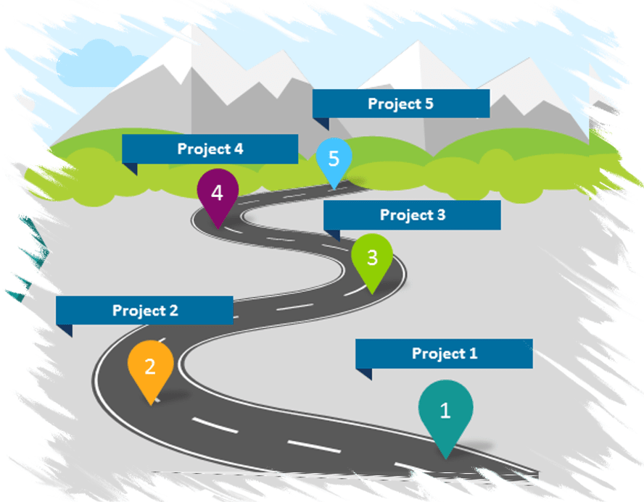
Roadmap
What are planned release Roadmaps?
July Mid 2024- SmartTown.MVP1 with Admin handling & Mostly free for 30Day
August End 2024-SmartTown.MVP2 Peer Approval & Money handling
October 2024- SmartTown.Stable
January 2025- SmartTown.AI With AI expansion
Feb 2025-Next Projects ConnecTogether, UnWell.in , Hennu.in & More in loop …
Always iterative development & Researches are ongoing
MVP: Minimum Viable Product

Slide 18

What we are looking?
Join us in building a network of transparent and connected towns and cities for making SmartTown!
We are seeking for support to accelerate our growth.
We always happy to hear smart ideas ,suggestions , Improvements, Corrections

Slide 19

Contact Us
How to Reach Us, For More Discussion ?
Email: Katthe@Outlook.in
Website: https://www.Katthe.com
Project1:https://www.SmartTown.in
Phone: +91-9482696525

